Slide 1
Home buying : Predicting the future
What makes a house a home?
What Metrics will help evaluate the right Home for the right price

Slide 2
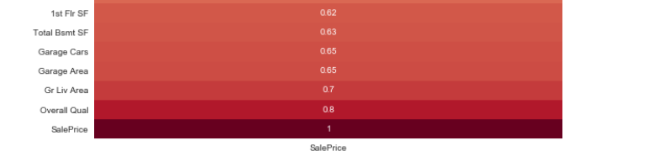
What are the traditional factors?
Location
House Measurements
House Quality
A few more not purely metric requirments
Year built
Pool? No pool?
Fence no fence

Slide 3
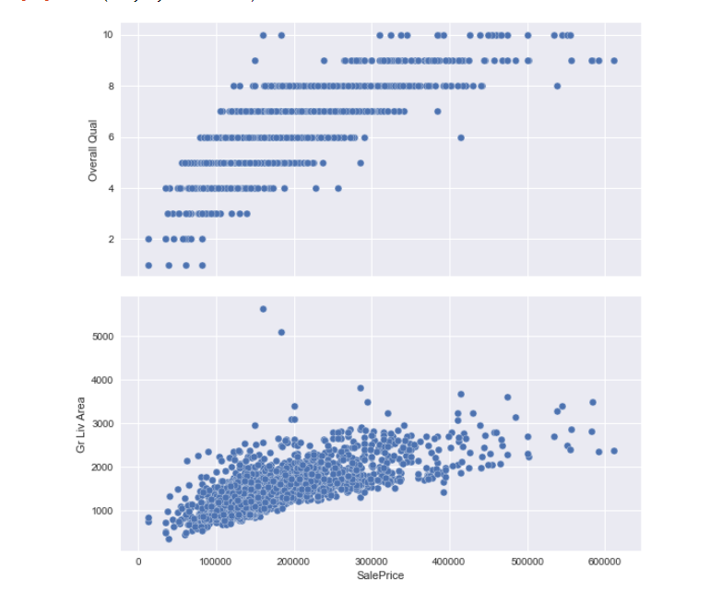
Overall Qual (Ordinal): Rates the overall material and finish of the house
10 Very Excellent
9 Excellent
8 Very Good
7 Good
6 Above Average
5 Average
4 Below Average
3 Fair
2 Poor
1 Very Poor

Slide 4
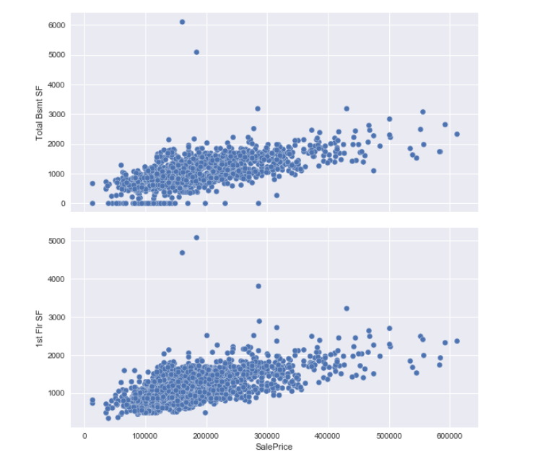
Total Basement Squarefeet - Increase sqft, increase sale price First Floor Squarefeet -Increase sqft, increase sale price

Slide 5
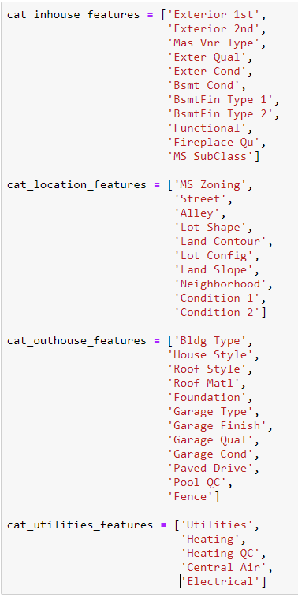
Account for the Intangible
- To make our model predictive
- Correlate with house features
- Correlate with location
- Correlate with external factors
List of All list of Categories for reference
inside_numerical_house_features
outside_numerical_house_features
cat_inhouse_features_dummies
cat_location_features_dummies
cat_outhouse_features_dummies
cat_utilities_features_dummies
cat_time_features_dummies

Slide 6
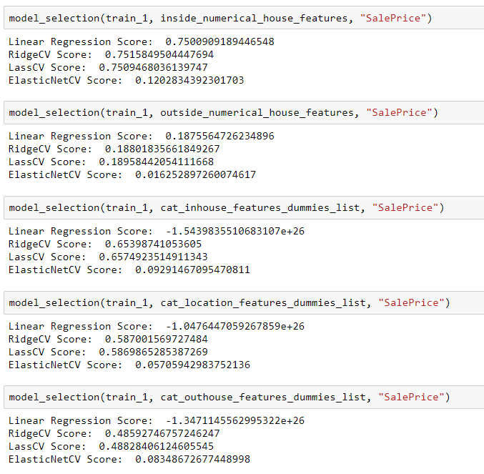
Test Against Sale Price
Test those features categories
In house features
Location features

Slide 7
In-Tangibles Matter
The best models Include
The house measurements: sqft, room count, bathroom count, basement
Location criteria: Lot size, configuration, neighborhood
Features of the house: Garage, Home Style, Roof Style
Recommendations
Location, Particular Features, and Home size matter
Tailor the home models to these criteria will ---
Improve traffic to Zillow through tailored feature selection
Improve home purchases by reducing features non-essiential to buyers
Improve realtor consultation by advising them of features

